Slide 1
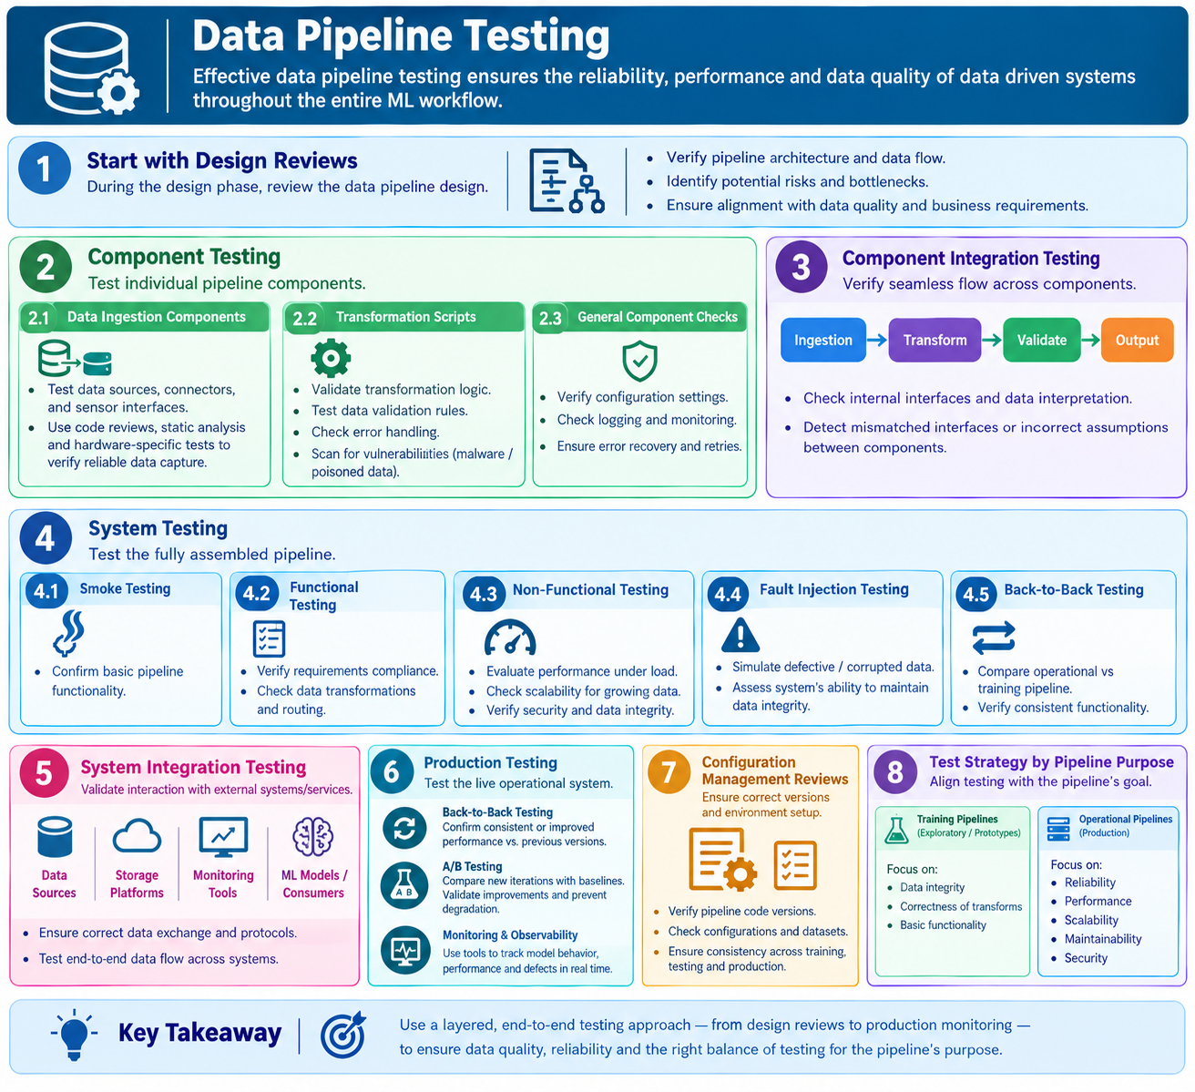
5.1.3 Data Pipeline Testing

Slide 2
5.1.3 Data Pipeline Testing
Data pipeline testing is essential for ensuring the reliability, performance, and quality of data-driven systems.
It helps maintain high data quality throughout the entire Machine Learning (ML) workflow (
A layered testing approach is used to verify the functionality, integration, performance, and security of the data pipeline at different testing levels.
Data Pipeline Design Reviews
Data pipeline design reviews are performed during the design phase to identify potential defects before implementation begins.
These reviews evaluate the pipeline architecture, data flow, interfaces, and data processing requirements to ensure that the pipeline is designed to handle data correctly and efficiently.

Slide 3
5.1.3 Data Pipeline Testing
2. Component Testing
Component testing focuses on testing individual components of the data pipeline, such as data ingestion components, transformation scripts, and sensor interfaces.
Testing techniques such as code reviews, static analysis, and hardware-specific testing are used to verify reliable data capture and processing.
Component testing includes the following activities:
Validating data transformation logic to ensure that data is processed correctly.
Verifying the implementation of data validation rules.
Checking error handling mechanisms to ensure the system can handle invalid or unexpected data.

Slide 4
5.1.3 Data Pipeline Testing
3. Component Integration Testing
Component integration testing verifies that data flows correctly between the internal components of the pipeline.
It ensures that data is transferred, interpreted, and processed consistently across different interfaces.
This testing helps identify defects caused by mismatched interfaces, incompatible data formats, or incorrect assumptions between components.

Slide 5
5.1.3 Data Pipeline Testing
4. System Testing
System testing evaluates the complete data pipeline after all components have been integrated.
It includes several testing approaches to verify the pipeline's functionality, performance, security, and reliability.
a. Smoke Testing
Smoke testing confirms that the basic functionality of the data pipeline is working correctly before detailed testing begins.
b. Functional Testing
Functional testing verifies that the data pipeline meets specified requirements, including correct data transformations, processing, and routing.
c. Non-Functional Testing
Non-functional testing evaluates the performance, scalability, and security of the data pipeline.
It verifies that the pipeline can handle increasing data volumes, operate efficiently under heavy loads, and protect data integrity.
d. Fault Injection Testing
Fault injection testing evaluates the robustness of the data pipeline by deliberately introducing defective, unexpected, or corrupted data.
It verifies whether the pipeline can detect errors, handle failures, and maintain data integrity under abnormal conditions.
e. Back-to-Back Testing
Back-to-back testing (see Section 6.1.10) compares the operational pipeline with the training pipeline to verify that both produce consistent results and perform the required data processing correctly.

Slide 6
5.1.3 Data Pipeline Testing
5. System Integration Testing
System integration testing verifies the interaction between the data pipeline and external systems or services.
These external systems may include data sources, storage platforms, monitoring tools, and downstream consumers such as Machine Learning models.
The objective is to ensure that data is exchanged correctly and that the pipeline operates properly within the overall system environment.

Slide 7
5.1.3 Data Pipeline Testing
6. Testing in Production
Testing in production is performed on the operational data pipeline to ensure that it continues to function correctly in a live environment.
The following testing approaches are commonly used:
a. Back-to-Back Testing
Back-to-back testing compares the current operational pipeline with previous versions to verify that performance and functionality remain consistent or have improved.
b. A/B Testing
A/B testing (see Section 6.1.9) compares a new version of the data pipeline with an existing baseline version.
This helps determine whether the new version provides improvements without negatively affecting the live data stream.
c. Continuous Monitoring
Monitoring tools are integrated into the operational pipeline to continuously observe data processing, model behavior, performance, and potential defects in real time.
Continuous monitoring helps identify problems early and maintain the reliability of the operational system.

Slide 8
5.1.3 Data Pipeline Testing
7. Configuration Management Reviews
Configuration management reviews verify that the correct versions of pipeline code, configuration settings, and datasets are used across training, testing, and production environments.
These reviews help prevent defects caused by incorrect configurations, mismatched versions, or inconsistent datasets.

Slide 9
5.1.3 Data Pipeline Testing
8. Testing Strategies for Training and Operational Pipelines
The testing strategy should be aligned with the purpose of the data pipeline.
a. Training Pipeline Testing
Training pipelines are often developed as exploratory prototypes and are primarily used to prepare data for ML model training.
Testing these pipelines mainly focuses on data quality, data integrity, and correctness of data transformations.
b. Operational Pipeline Testing
Operational pipelines process data in production environments and must function reliably under real-world conditions.
Testing these pipelines primarily focuses on reliability, performance, scalability, security, and maintainability.

Slide 10
5.1.3 Data Pipeline Testing
Summary of Data Pipeline Testing
Key Takeaway: Data pipeline testing ensures that data is collected, transformed, transferred, and processed correctly throughout the ML workflow. It combines different testing levels and techniques to maintain data quality, prevent defects, protect data integrity, and ensure reliable ML system operation.
Testing Level | Main Purpose
Design Reviews | Verify the pipeline architecture and design
Component Testing | Test individual pipeline components
Component Integration Testing | Verify data flow between internal components
System Testing | Test the complete pipeline's functionality and quality
System Integration Testing | Verify interactions with external systems
Testing in Production | Validate the pipeline in a live environment
Configuration Management Reviews | Verify correct code, configurations, and datasets
Training Pipeline Testing | Focus on data integrity and correctness
Operational Pipeline Testing | Focus on reliability, performance, and maintainability

Slide 11
THANK YOU!!!

